Slide 1


KIOTA
2022
Crea un SDK para cualquier API en cuestión de minutos
17/09/2022

Slide 2
About Me

Slide 4

NEST (from Swahili)

Slide 5

What is Kiota?
Kiota is a command line tool for generating an API client to call any OpenAPI described API you are interested in. The goal is to eliminate the need to take a dependency on a different API SDK for every API that you need to call. Kiota API clients provide a strongly typed experience with all the features you expect from a high-quality API SDK, but without having to learn a new library for every HTTP API.
Fast and scalable source code generator to simplify calling HTTP APIs
Provide support for a wide range of languages: C#, Java, Typescript, PHP, Ruby, Go, Python, Swift, Shell
Enable low effort implementation of new language support
Generate code that enables IDE autocomplete to aid in API resource discovery
Lightweight, easy to install command line tool
Enable generation of code for only a specified subset of an OpenAPI description
PUBLIC PREVIEW
https://microsoft.github.io/kiota/

Slide 6
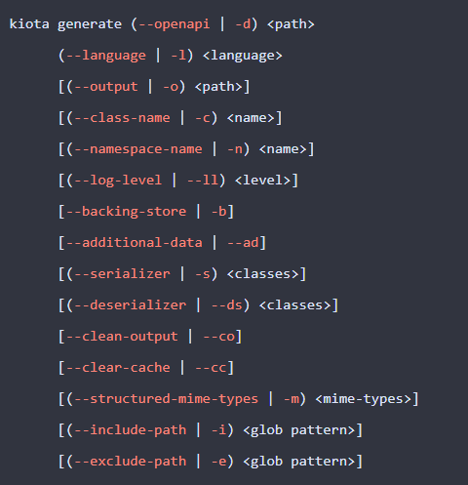
kiota generate --openapi openapi.json --language csharp --output client

Slide 7

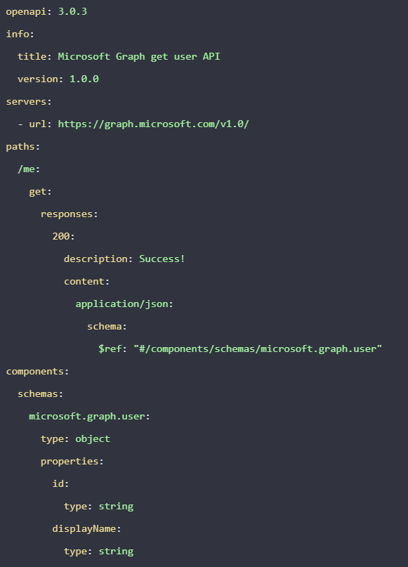

The OpenAPI Initiative (OAI) was created by a consortium of forward-looking industry experts who recognize the immense value of standardizing on how APIs are described. As an open governance structure under the Linux Foundation, the OAI is focused on creating, evolving and promoting a vendor neutral description format. The OpenAPI Specification was originally based on the Swagger Specification, donated by SmartBear Software.
https://oai.github.io/Documentation/

Slide 8
Let´s Dive In!

Slide 9






Teamified Demo Architecture
Azure Active Directory
Teamified
App
C# SDK
graph.microsoft.com
Teamified
API
SharePoint
Teamified SPFx
WebPart
TS SDK
Kiota
generated

Slide 10
https://github.com/luismanez/netcoreconf-madrid-2022

Slide 12
More information:
info@netcoreconf.com
@Netcoreconf
Visit on:
netcoreconf.com
Thanks

